Slide 1




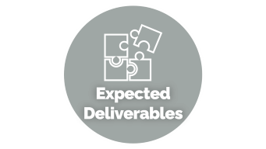


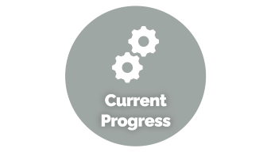
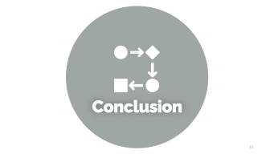





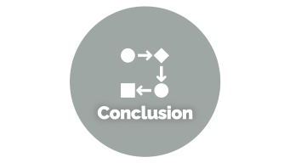
Design and Development/Prototyping of a Stable Platform
Group Members:
Syed Salar Hussain
Muhammad Saad Abdullah
Syeda Urooj Bukhari
Ahmed Asim
Project Advisors:
Capt. Dr. Sajjad Ali Haider Zaidi
Dr. Adil Loya
Notes:
https://unsplash.com/photos/AXu2aZ3YgP8

Slide 2

Problem
Statement

Slide 3
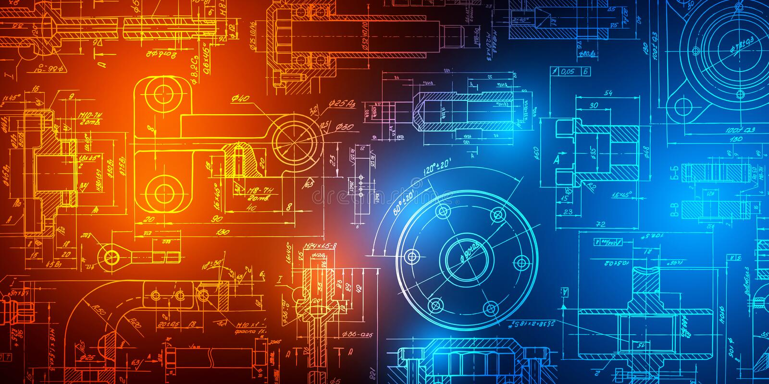

Problem Statement
The Problem
The Solution
Objects such as motion platforms and stable platforms are usually used in high-end applications and state-protected sectors which include the aviation and military sectors. They are generally very expensive.
The importance of these platforms being accessible to the general public refers to the availability of the concept and algorithm in sectors that facilitate the general public.
The aim of the project is to provide a low-cost solution for state-protected objects in order to make them accessible to the general public
Frasca International Inc. (2021b) How much does a Frasca simulator cost? https://www.frasca.com/how-much-does-a-frasca-simulator-cost/
Next Level Racing: MOTION PLATFORM V3 https://nextlevelracing.com/products/next-level-racing-motion-platform-v3/
Notes:
https://unsplash.com/photos/fItRJ7AHak8

Slide 4

Methodology

Slide 5




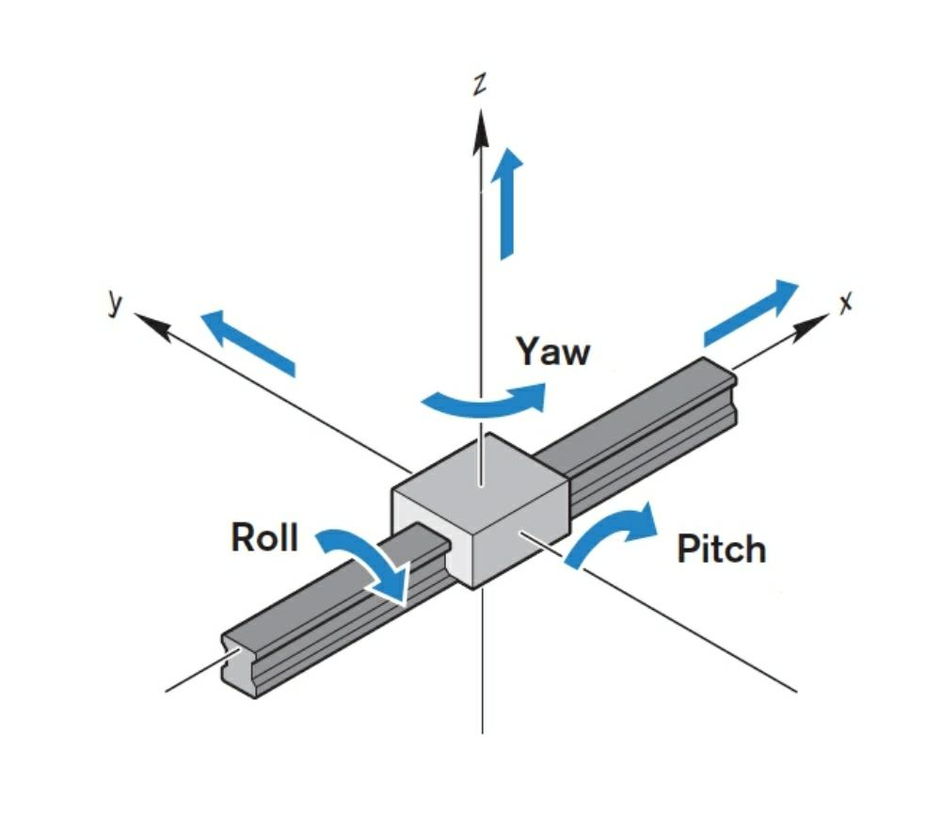
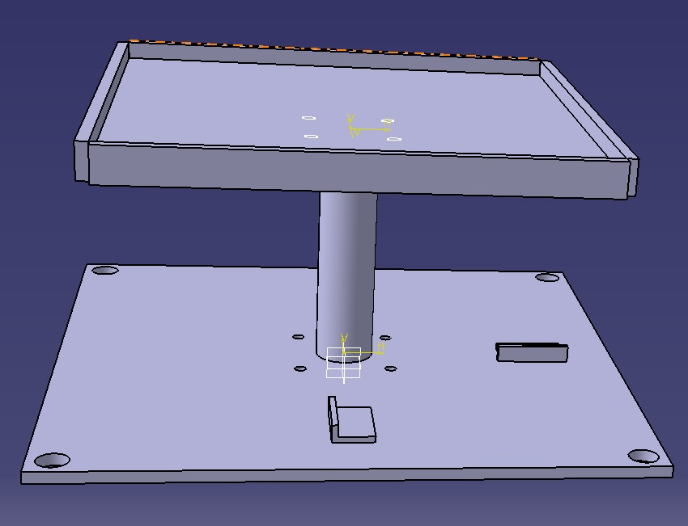
Part Design
Assembly Design
The Structure
Functions Used
Moving Platform
Spherical Ball-Joint
Support Column
Base
Motor Mounts
Notes:
https://unsplash.com/photos/48nerZQCHgo

Slide 6


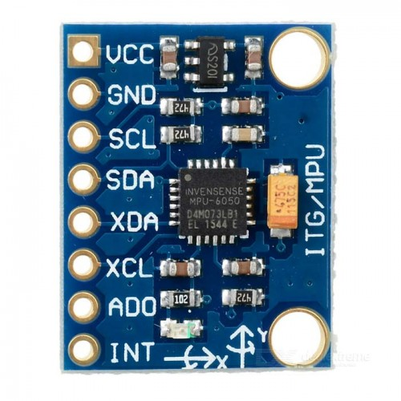
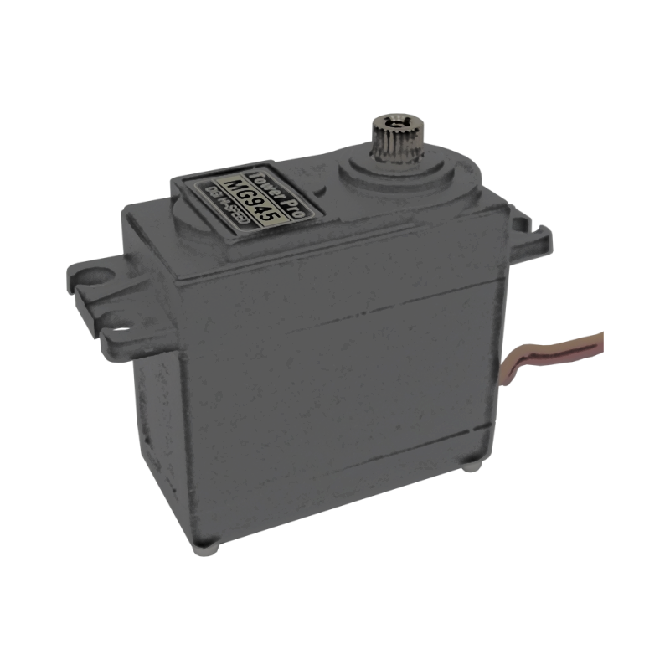
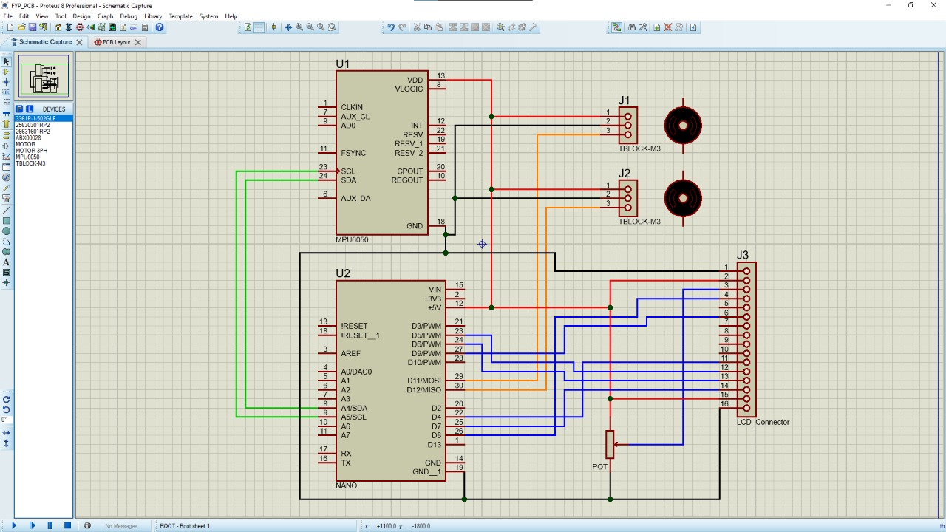
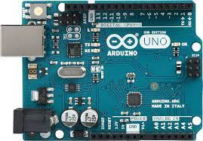
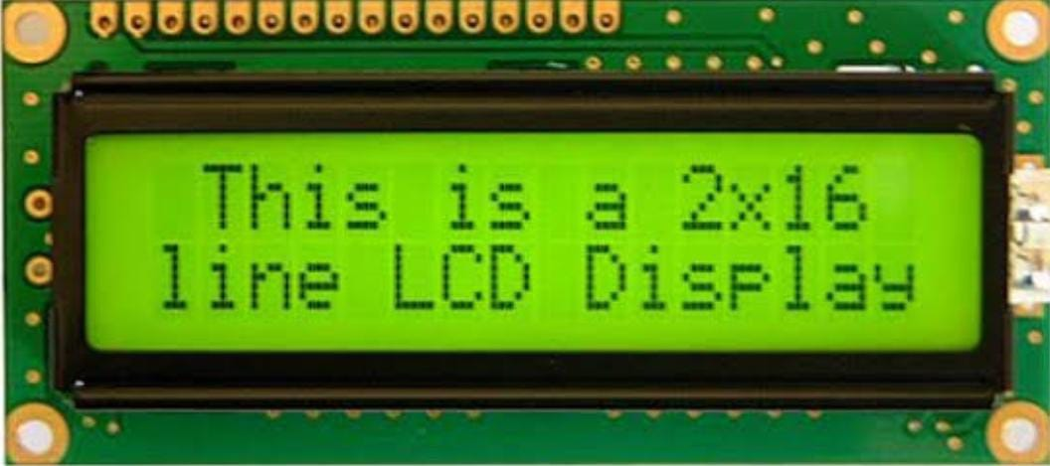
MPU6050
Tower Pro MG945
The Electronics
3-Axis Gyro and Accelerometer
Sensing inertial position
Quantity: 1
DC Servo Motor
Operating Speed: 0.23sec/60degree
Torque: 12kg/cm (1.18Nm)
Quantity: 2
Arduino Uno
16x2 LCD
Microcontroller
I2C Protocol
Clock Speed: 16KHz
8-bit operation mode
Micro-controller
Motors
Sensor

Slide 7

Expected
Deliverables

Slide 8




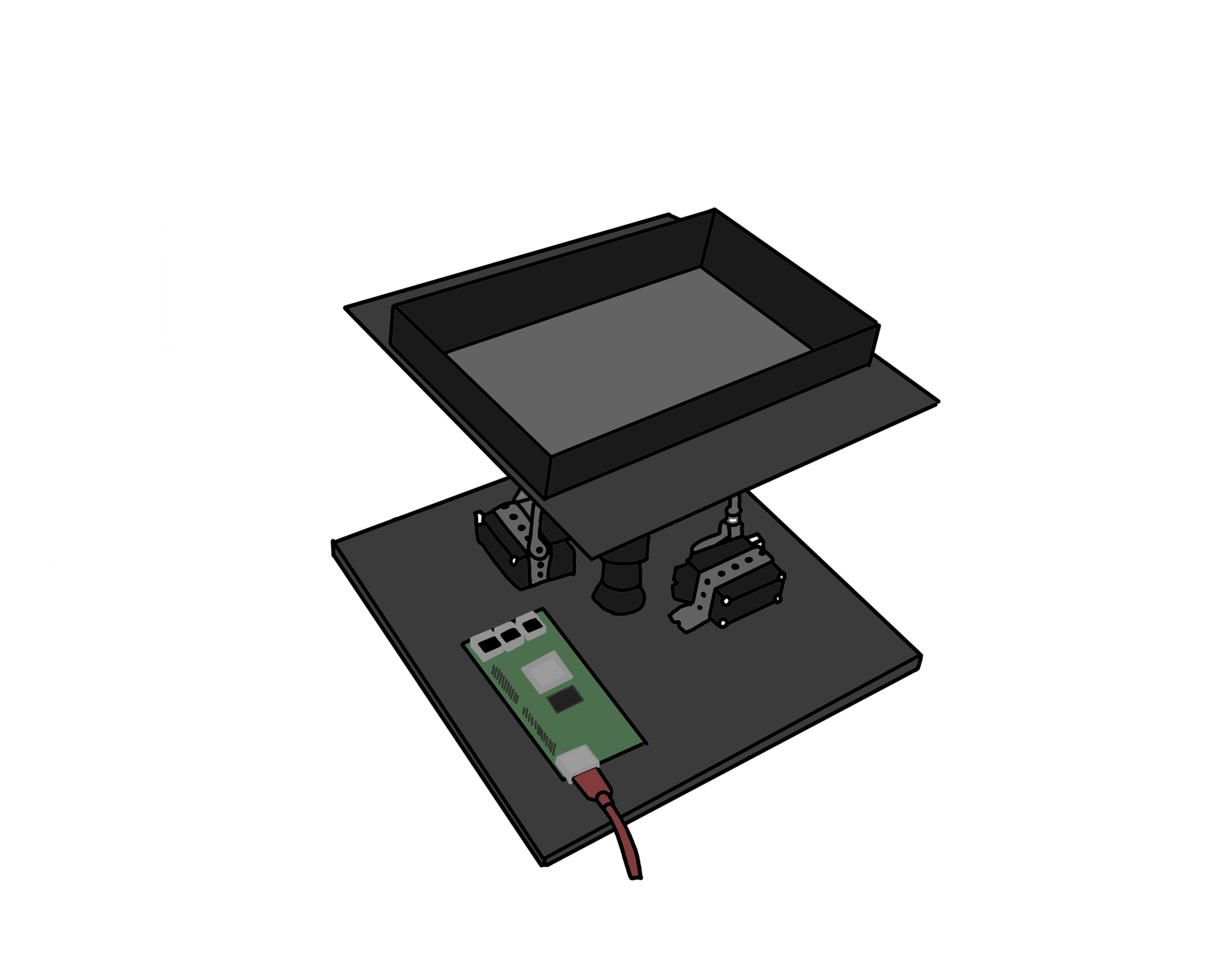
Expected Deliverables
02
04
Closed-loop Control System
10 Degree Correction
2 DOF
Final Demonstration with
500g
4kg
10kg
Induced Disturbance
MPU feedback to Microcontroller
Pitch Motor
Servo arm
adjustment
Sensor
01
Position Sensing
03
Signal to Actuators
05
Arduino
Roll Motors
Munana, B., 2022. A Self-Stabilizing Platform
Notes:
https://unsplash.com/photos/TvN54bnuQg8

Slide 9

Data Acquisition

Slide 10


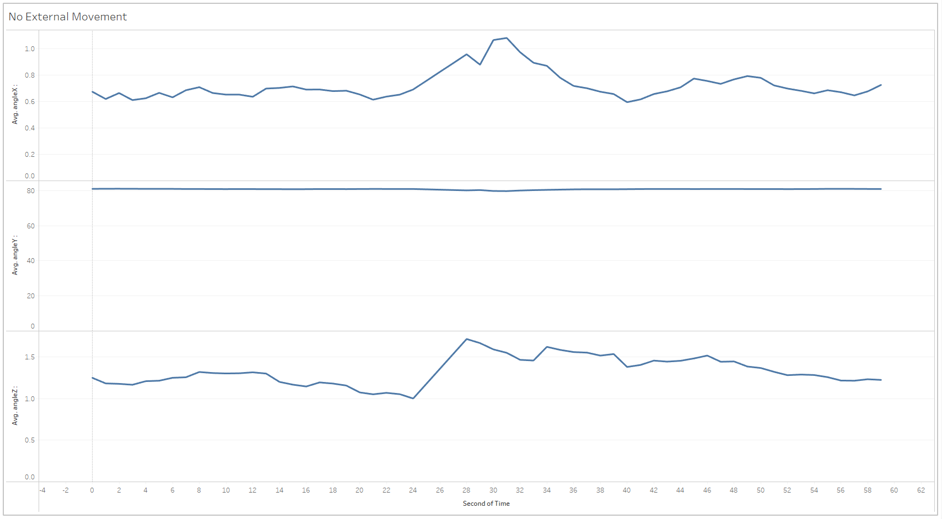
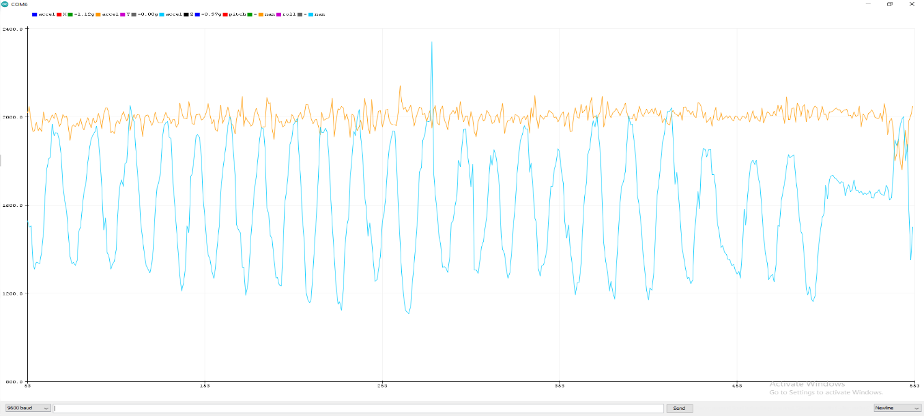
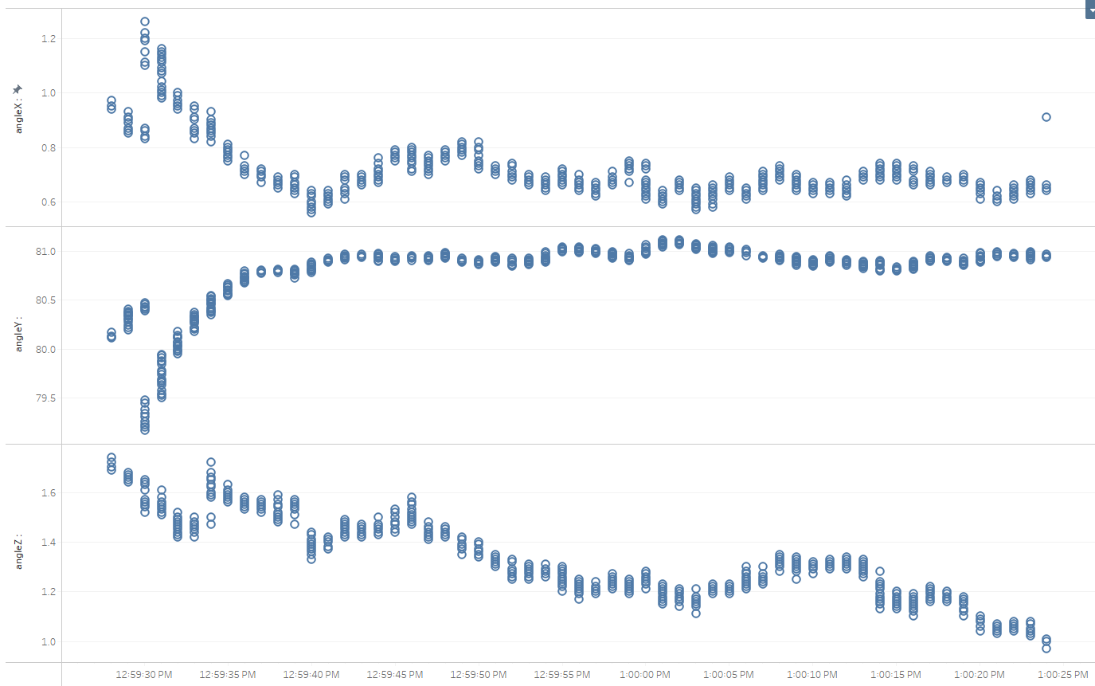
Data Acquisition
Roll
No External Force on Sensor
Plots of individual readings
3 Axis Plots
Pitch
Roll
Avg. Roll
Angle
Avg. Pitch
Pitch
Avg. Yaw
Yaw
Time
Time in seconds
Notes:
https://unsplash.com/photos/fItRJ7AHak8

Slide 11

Implementation

Slide 12


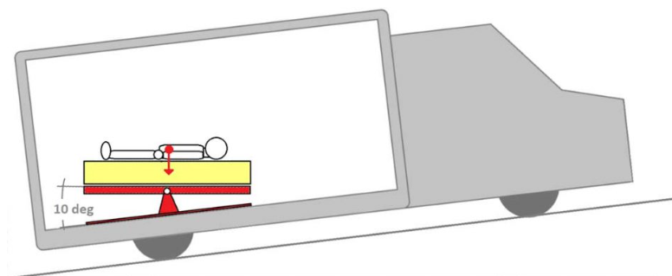
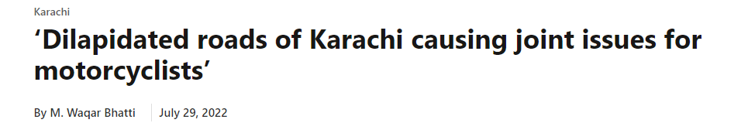


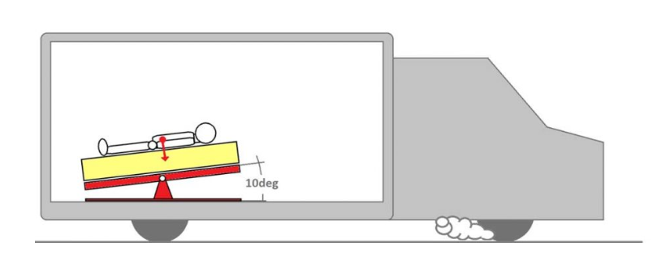


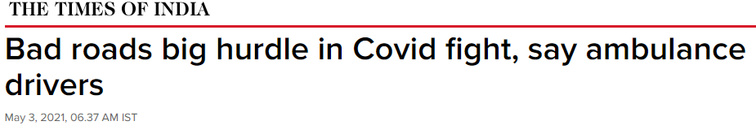



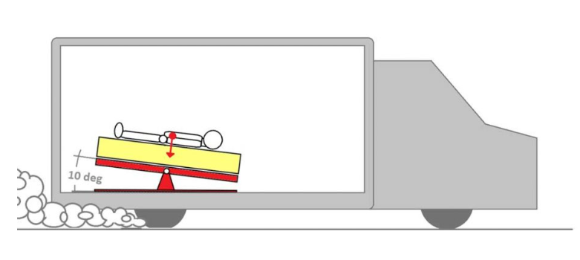
Implementation
Potential Market
Aerospace
Medical
22%
65%
4%
Stable Stretchers
Stable ambulance stretchers can be used for emergency transportation of critically ill or injured patients by ensuring maximum safety and comfort by countering any external disturbances
USA
INDIA
Pakistan
Out of 320.7 million (2015)
Out of 1.31 billion (2015)
Out of 199.4 million (2015)
Zia, N., Shahzad, H., Baqir, S.M. et al. Ambulance use in Pakistan: an analysis of surveillance data from emergency departments in Pakistan. BMC Emerg Med 15 (Suppl 2), S9 (2015).
Notes:
https://unsplash.com/photos/TvN54bnuQg8

Slide 13

Conclusion

Slide 14
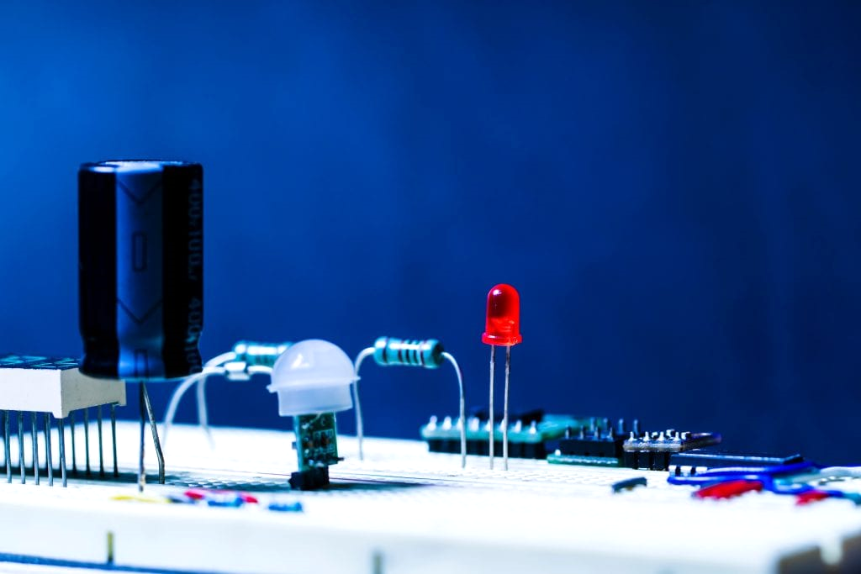
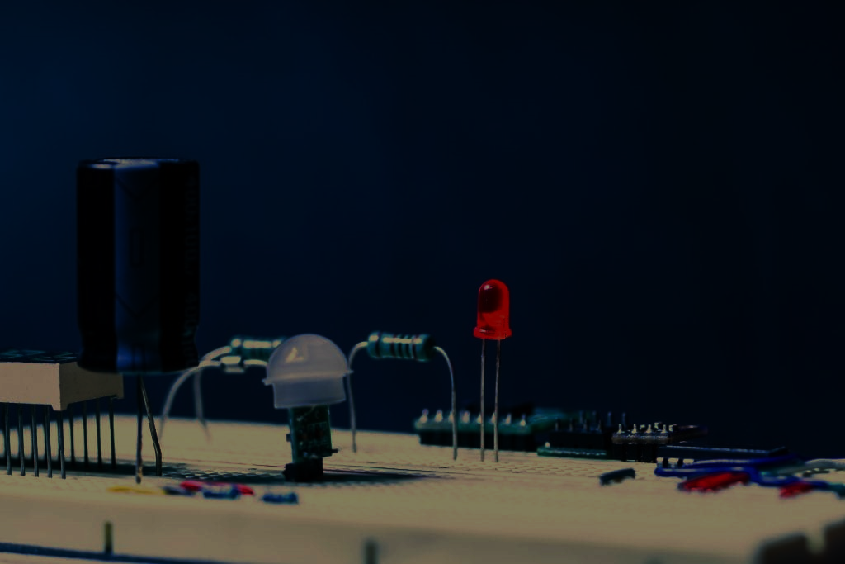
Conclusion
In short, it can easily be stated that projects as such stable platform have potential to be one of the most lucrative and sustainable engineering projects of the modern age
Notes:
https://unsplash.com/photos/GKLIsLZxhj0

